Slide 1
Logging Fundamentals

Slide 2
Logs help developers and administrators track the application's behavior and troubleshoot issues.
Common log levels include DEBUG, INFO, WARN, ERROR, and FATAL.
Overview
Benefits:
Helps in diagnosing issues.
Provides insights into application performance.
Useful for auditing and security monitoring.
Real-world Use Cases:
Error tracking and resolution.
Monitoring system health and performance.
Ensuring compliance and security audits.

Slide 3
SLF4J (Simple Logging Facade for Java) provides a simple interface for logging in Java applications. Acts as a facade or abstraction layer over various logging frameworks (e.g., Log4j, java.util.logging, Logback).
Decouples the application code from the underlying logging framework, allowing flexibility in changing the logging backend.
Introduction to SLF4J
Core Components:
Logger Interface
LoggerFactory
Binding

Slide 4
Logback is a popular, open-source logging framework for Java applications, created by the same author as Log4j. It is designed to be a more modern and efficient alternative to Log4j and java.util.logging. Logback is the default logging framework used by SLF4J, providing native support for the SLF4J API.
What is Logback?
Key Features:
High Performance
Automatic Log File Rolling
Flexible Configuration
Structured Logging
Logging Levels
Appenders and Layouts

Slide 5
Logback Architecture
Logback-core
Logback-classic
Logback-access

Slide 6
Components of Logback
o Logger
o Appender
o Layout
o Encoder

Slide 7
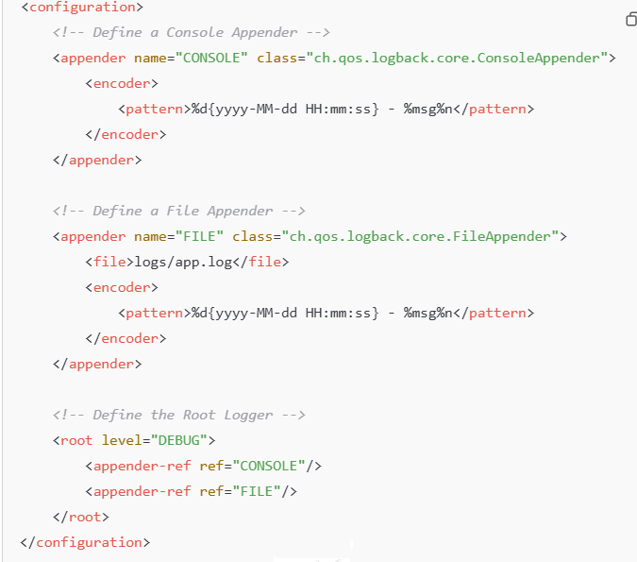
Example of Logback Configuration (logback.xml)

Slide 8
Parametrized Logging
Parameterized Logging refers to the technique
where log messages are constructed using
placeholders,
which are filled with dynamic values at runtime.
Instead of concatenating strings manually to
build a log message, placeholders are used,
and the values are inserted when the message
is logged.
SLF4J supports parameterized logging with {}
placeholders in the log message,
making it cleaner and more efficient.
Why use it
Performance Optimization
Simpler Code
Consistency and Safety
Localization Readiness

Slide 9
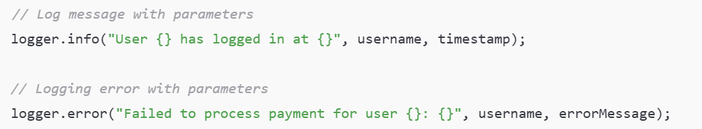
Example of Parameterized Logging with SLF4J

Slide 10
Logging Separation
Logging Separation refers to the practice of
ensuring that the logging responsibilities are
distinct and isolated from the business logic of
an application.
This separation allows for better code
organization, easier maintenance,
and clearer debugging processes.
By isolating logging concerns,
we reduce the risk of inadvertently affecting
the core functionality with logging code and
can change logging configurations or behavior
without impacting the application logic.
Why use it
Decoupling of Concerns
Maintainability and Flexibility
Consistency
Scalability

Slide 11
Techniques for Separating Logging Concerns
Why use it
Use of Logging Frameworks (e.g., SLF4J, Logback, Log4j)
External Configuration Files (logback.xml, log4j.properties
Use of Custom Loggers or Logging Aspects (Aspect-Oriented Programming)
Centralized Logging Systems (e.g., ELK Stack, Splunk)
Use of Logging Libraries and Logging Levels
Decoupling of Concerns
Maintainability and Flexibility
Consistency
Scalability

